Slide 1
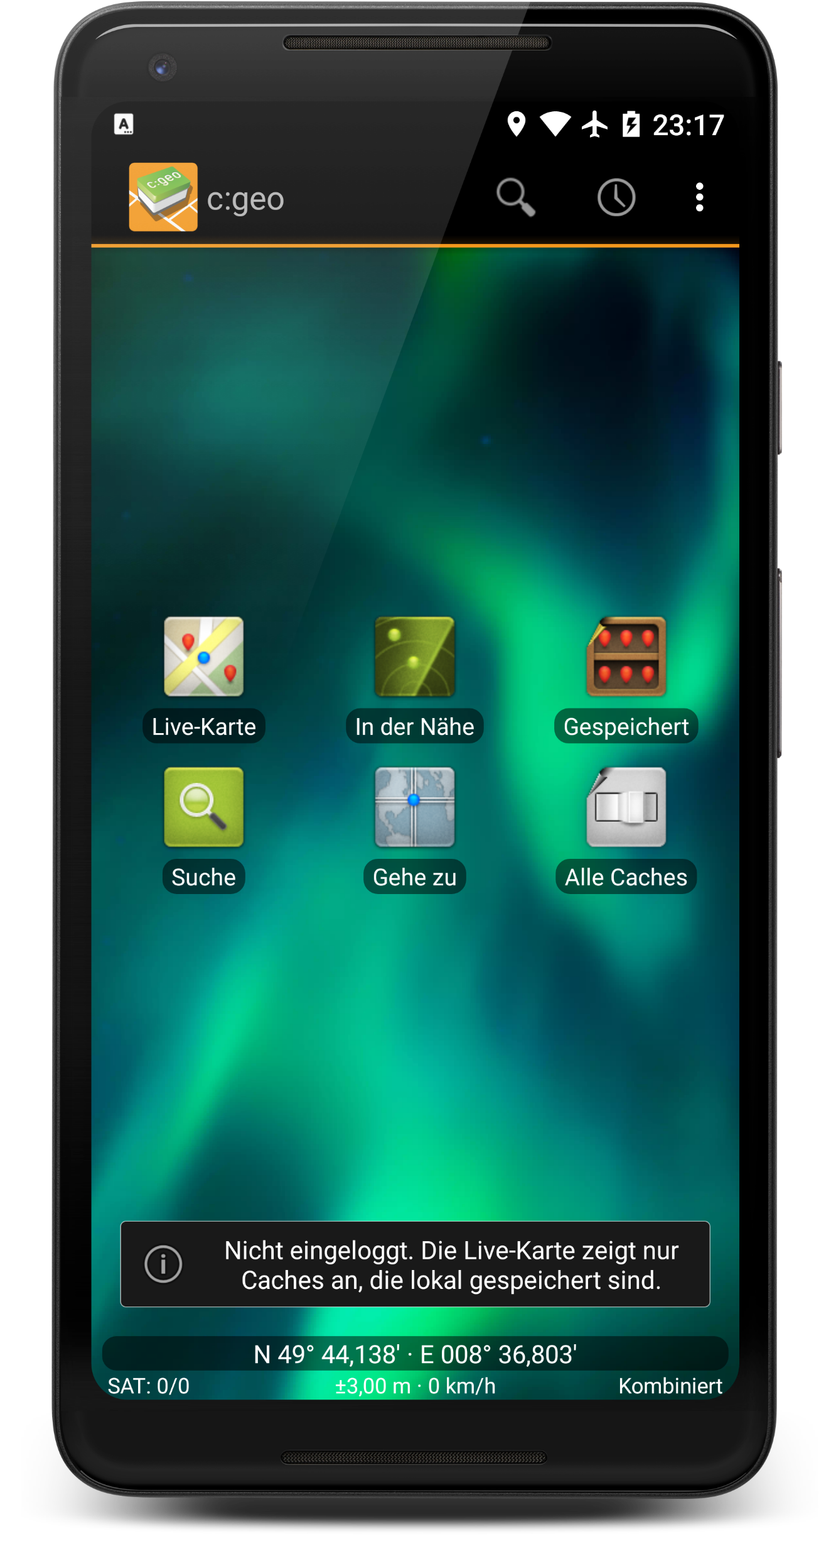
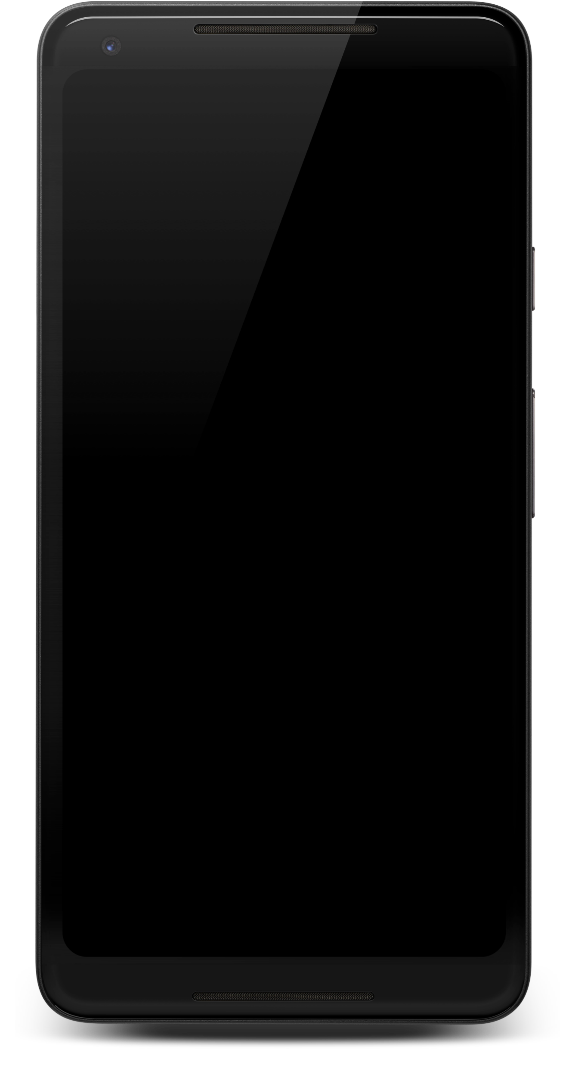
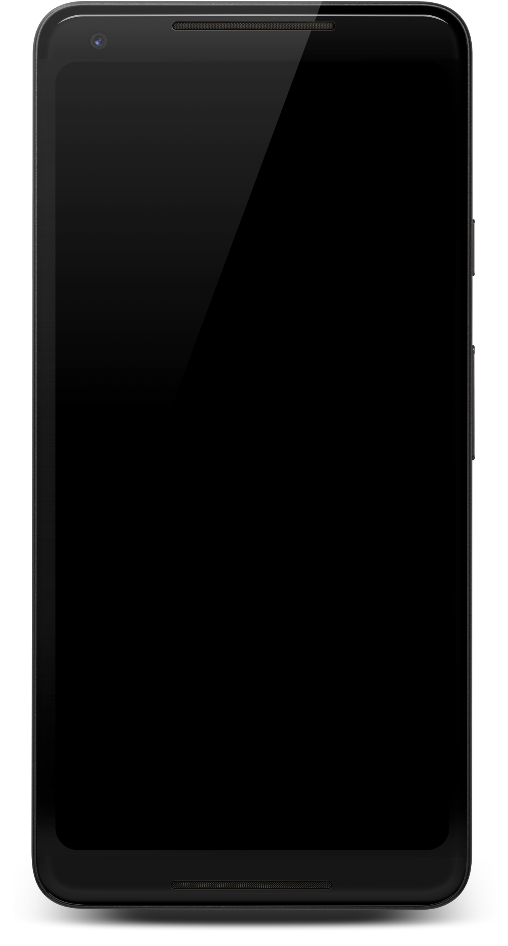

Slide 2


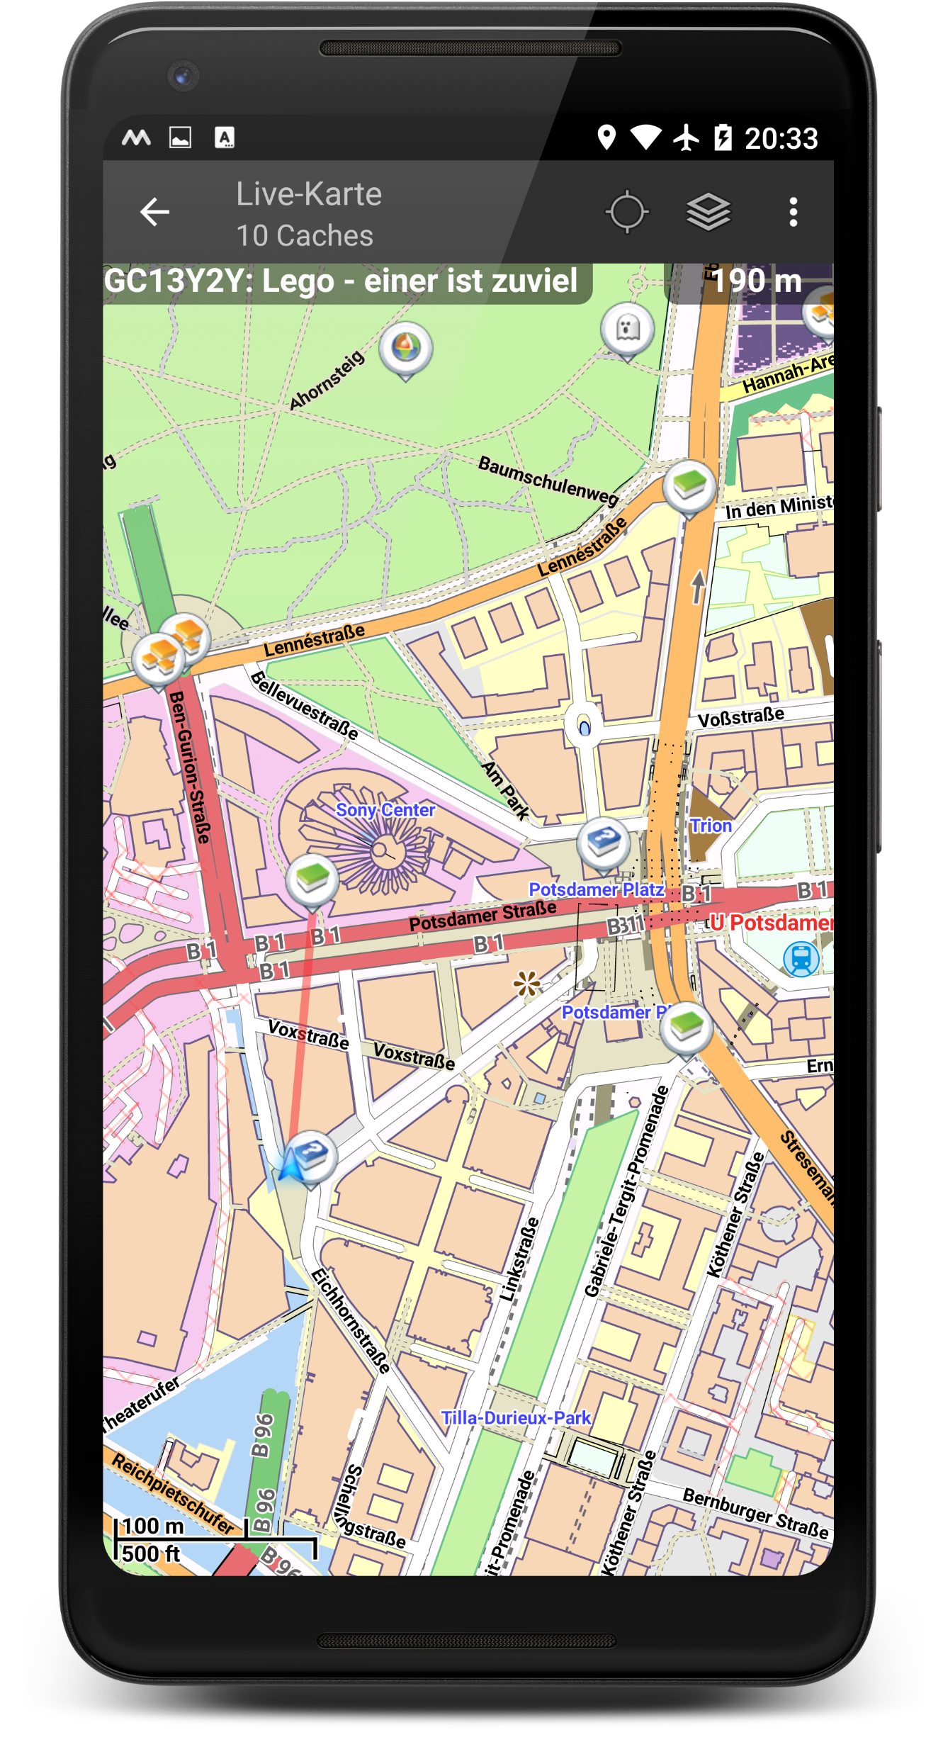
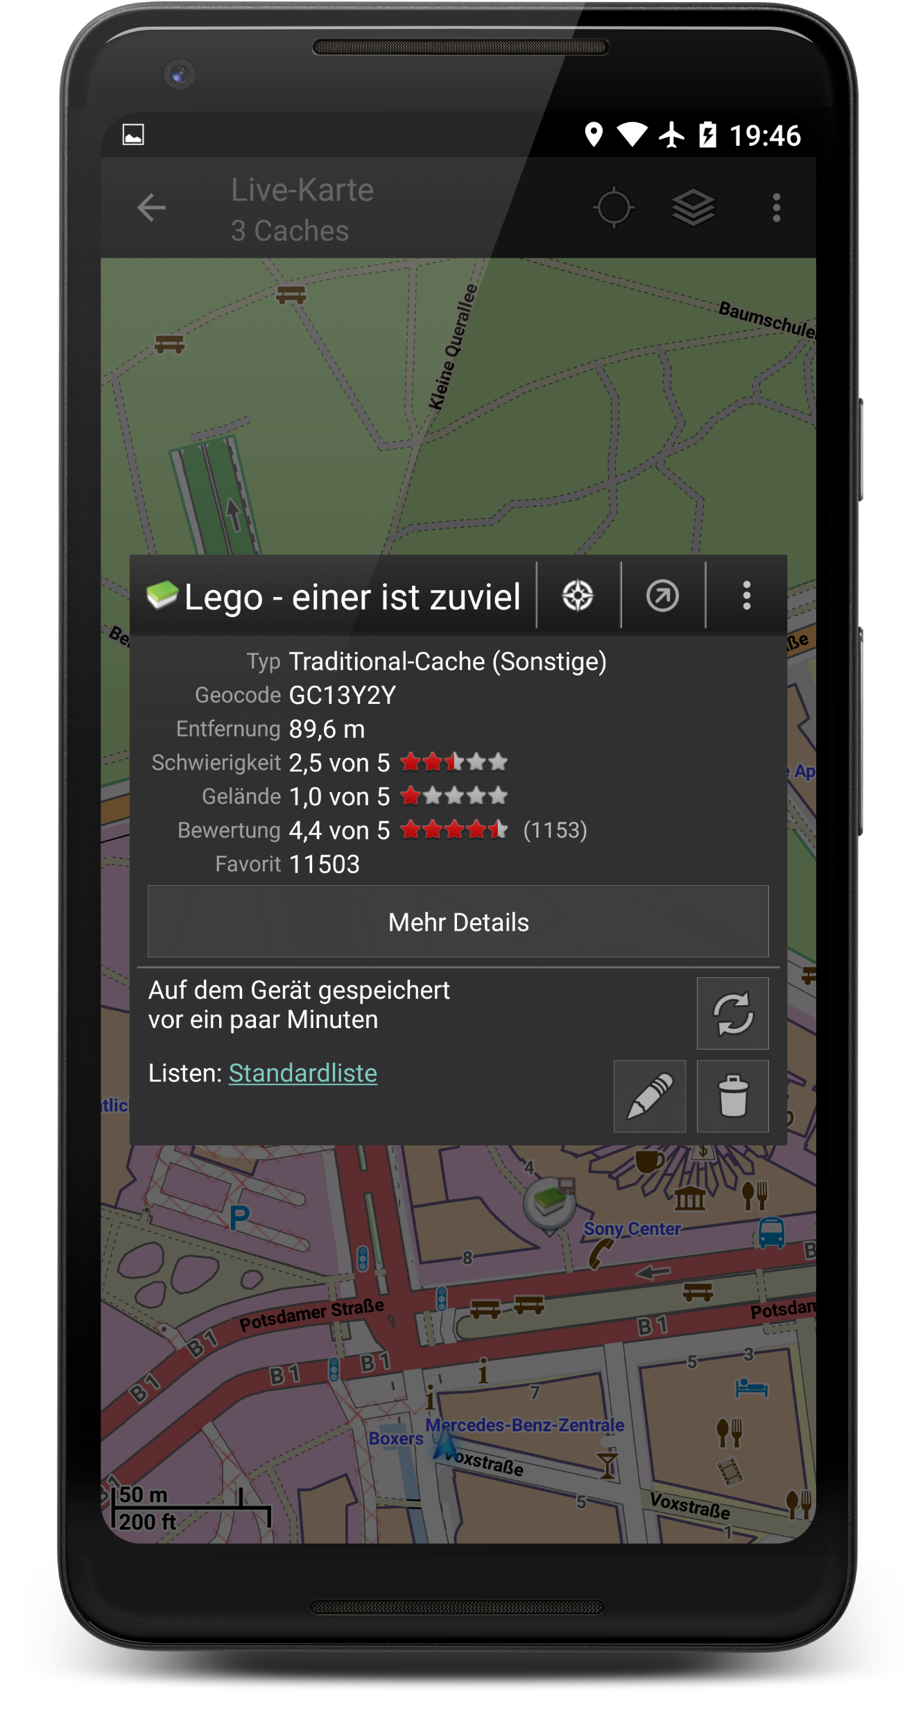
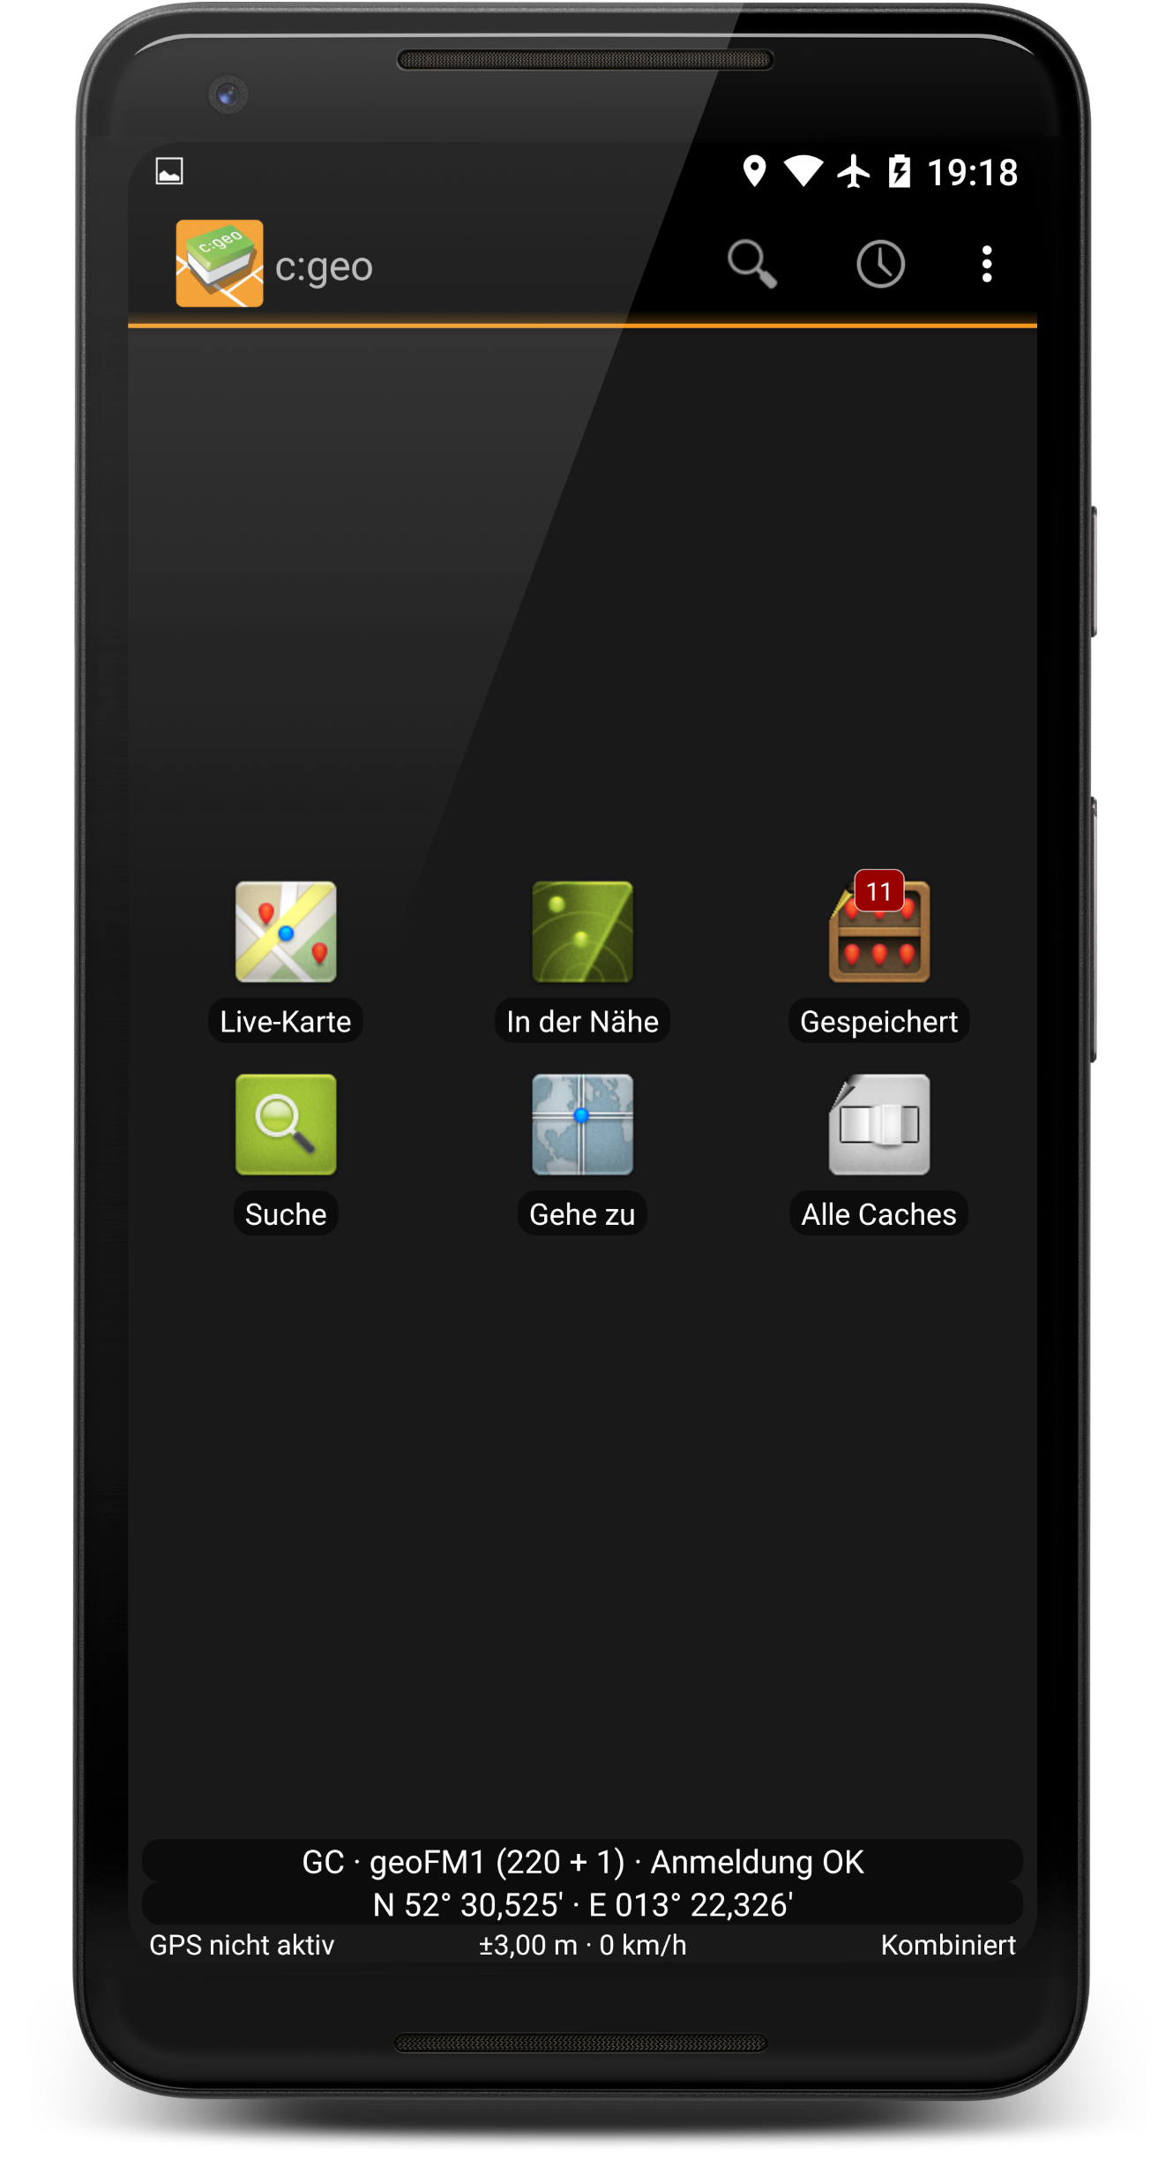
Interactive
Live-Map
Whatever
else
Over 5 supported
geocaching
platforms

Slide 3

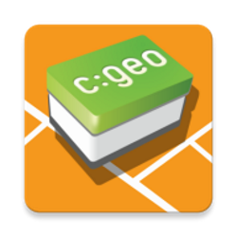
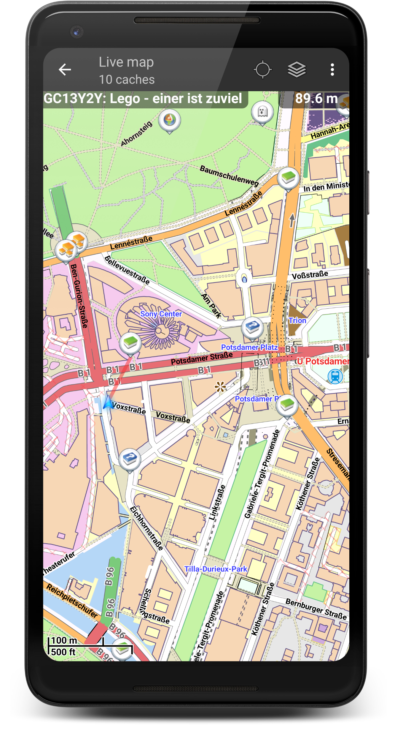
c:geo
Geocaching
for Android
Note: Used Font is 232MKSD Round
Screenshots: developer.android.com/distribute/marketing-tools/device-art-generator

Slide 5
Fangruppe

